Slide 1

Market Segmentation: PlayStation
DA6822

Slide 2

Objectives
Using the Simmons’ National Consumer Survey, we are tasked with determining the customers likely to purchase the newest PlayStation system.
Where should we focus our marketing efforts to maximize advertising and marketing expenditure?

Slide 3
Variables of Interest
Target Variable:
PlayStation – Brand Summary
Single Driver Variables:
“Video games are my main source of entertainment”
“I’m always the first among my friends to have the latest in electronic equipment”
“I’d pay just about anything for the electronic product I really want”
“I spend more time playing video games than watching TV”
“I always ask my friends advice before I buy any electronic equipment”

Slide 4
Abstract Constructs
1. How technologically involved is our consumer?
“I try to keep up with developments in technology”
“Technology is moving so fast I don’t even bother to try and keep up”
“I like to get as much information as possible about an electronic item before I buy it”
“I love to buy new gadgets and appliances”
2. What are the dietary habits of our consumer?
“I often snack between meals”
“I treat myself to foods not good for me”
“I often feel I over-eat”
“I make sure I exercise regularly”

Slide 5
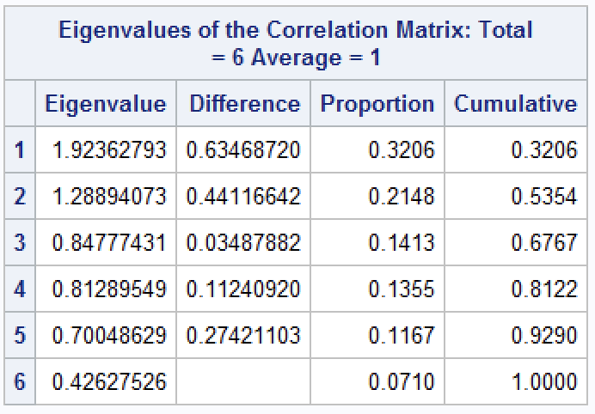
Principal Components Analysis
We use the Kaiser criterion for determining which factor to extract. We keep factors that have an eigenvalue greater than or equal to 1.
The cumulative amount of variance explained by our two extracted factors is 53.54%, with 32.06% explained by Factor 1 and 21.48% explained by Factor 2.

Slide 6
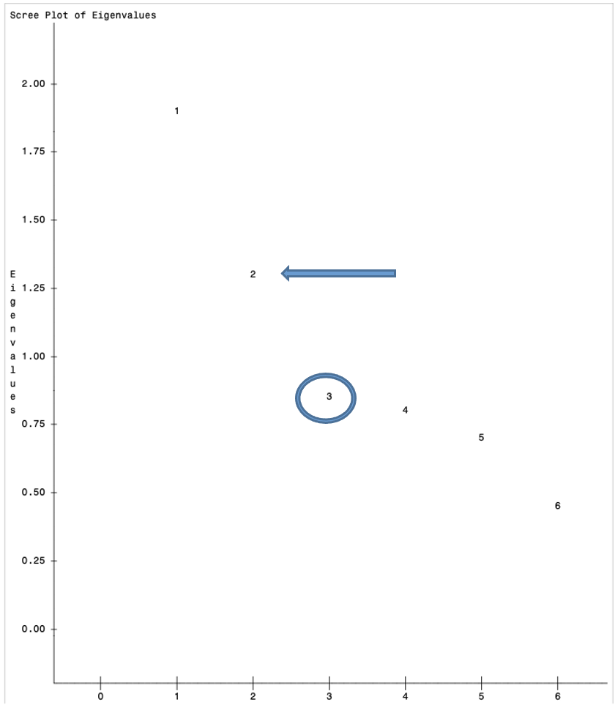
Scree Plot
The rule of thumb is to find where the descent in the plot stops and pick the value immediately prior. In our example, we see that our stopping point occurs at factors equal to 3, therefore we would select factors equal to 2.

Slide 7
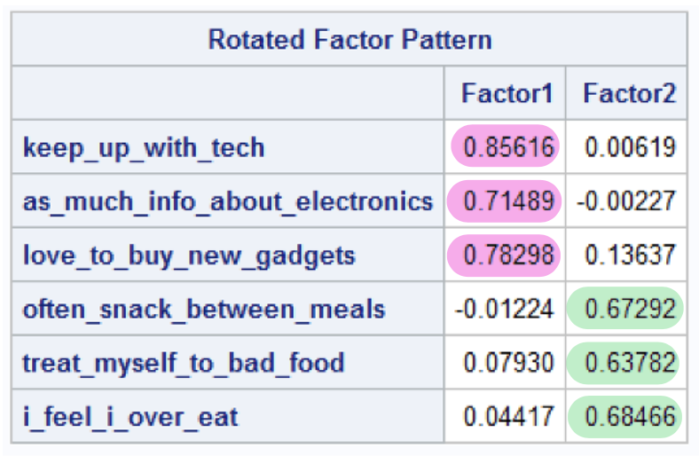
Rotated Factor Pattern
We examine the value for each variable and find where it loads the highest, anything greater than 0.6 is acceptable. We conclude that the first three variables load highly on Factor 1 and the last three variables load highly on Factor 2.
The presented factors represent a latent variable that is an unobservable common construct among their corresponding variables. Here, Factor 1 represents technological involvement and Factor 2 represents dietary habits.

Slide 8
K-means Cluster Analysis
Number of Clusters | R square | CCC | Pseudo F
3 | 0.26795 | 147.819 | 8102.11
4 | 0.33231 | 151.887 | 6959.95
5 | 0.38111 | 118.620 | 5599.23
6 | 0.42173 | 145.245 | 5547.24
7 | 0.44742 | 123.674 | 4717.70
8 | 0.46990 | 168.197 | 4836.63

Slide 9
From the CCC plot, we conclude that the first local maxima appears at k=4 clusters, and the second local maxima appears at k=6 clusters. We would inspect the cluster means at k=4 and compare to the cluster means at k=6 to evaluate which is the more optimal solution.
From the Pseudo F plot, we conclude that the first local maxima appears at k=6 clusters, which is also where the second local maxima for the CCC also appears. This suggests we keep 6 clusters.

Slide 10
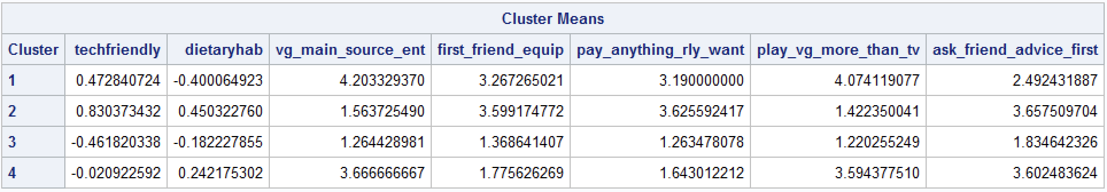
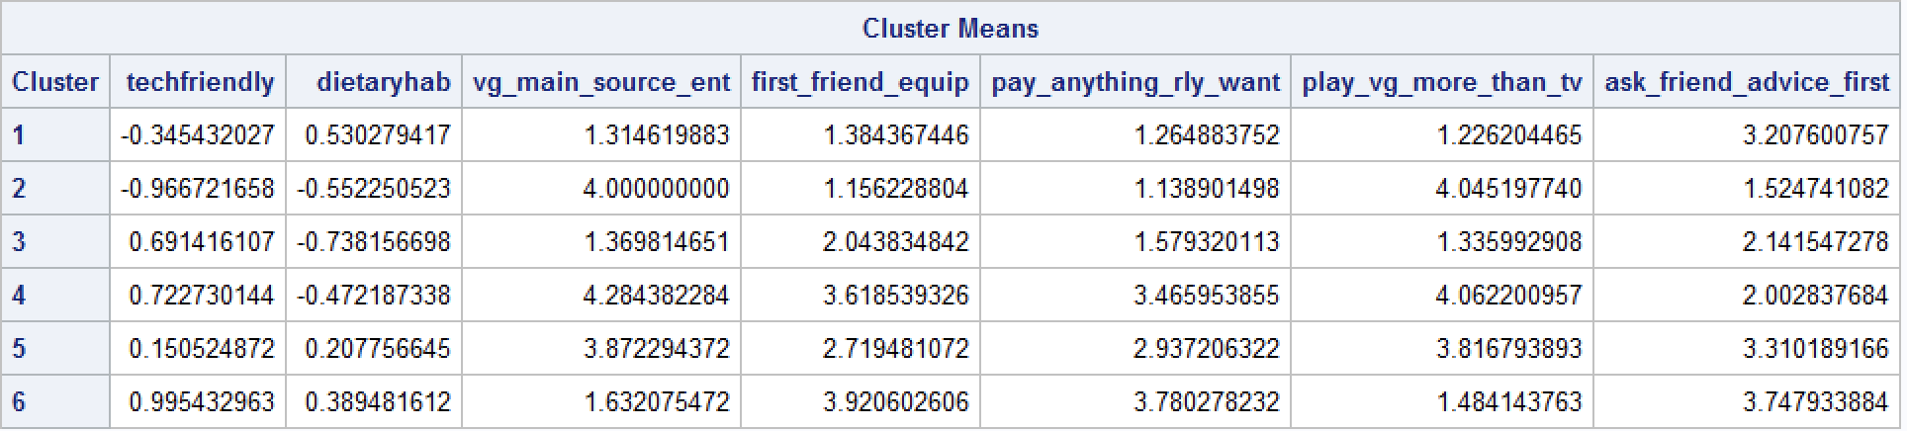
Cluster Means
K = 4
K = 6

Slide 11
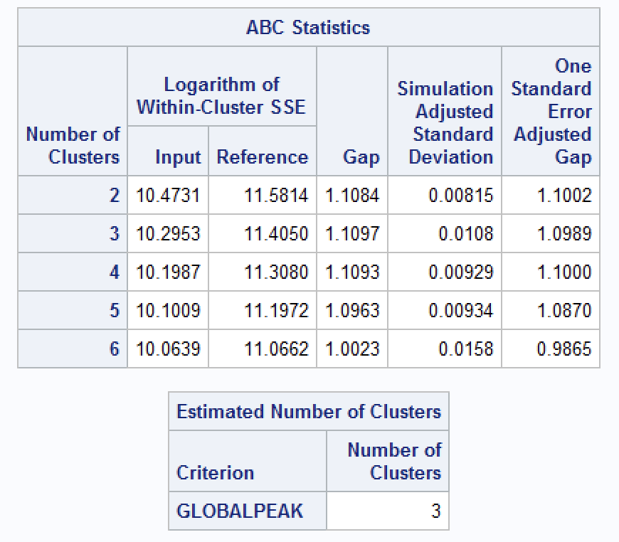
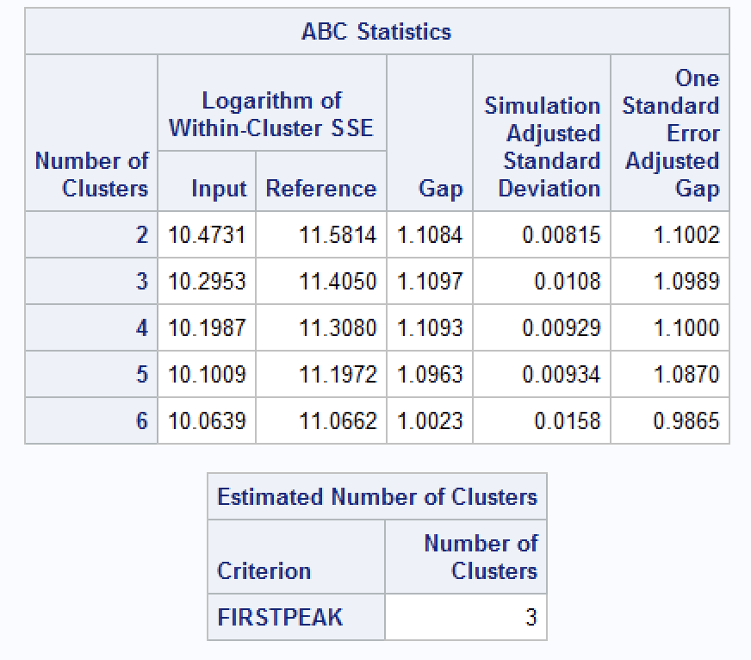
Gap Analysis

Slide 12
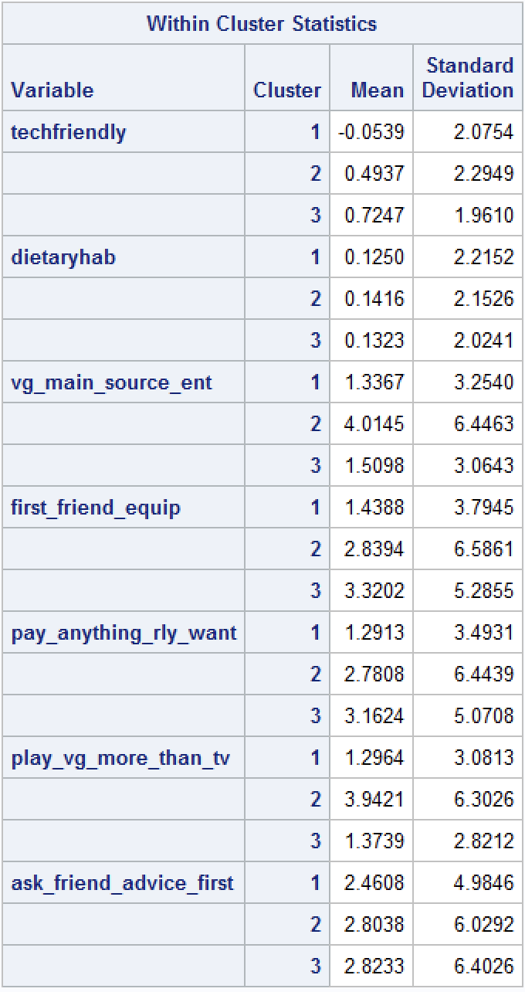
Gap Analysis Cluster Means

Slide 13
Descriptor Variables
Variable | Cluster 1 | Cluster 2 | Cluster 3 | Cluster 4 | Cluster 5 | Cluster 6
PlayStation | 0.0842 | 0.0472 | 0.1230 | 0.1631 | 0.1206 | 0.1751
Xbox | 0.0826 | 0.0441 | 0.1109 | 0.1414 | 0.1063 | 0.1567
Nintendo | 0.1378 | 0.0450 | 0.1660 | 0.1158 | 0.0993 | 0.1926
BestBuy | 0.1931 | 0.1278 | 0.2563 | 0.3001 | 0.1766 | 0.2788
MTV | 0.0663 | 0.0380 | 0.0762 | 0.1030 | 0.1166 | 0.1535
HBO | 0.1465 | 0.1298 | 0.1902 | 0.2349 | 0.1836 | 0.2481
McDonalds | 0.3562 | 0.3211 | 0.3159 | 0.2750 | 0.3268 | 0.3111
Male | 0.3630 | 0.4230 | 0.4426 | 0.5801 | 0.4906 | 0.4998
Video Ads | 0.0137 | 0.0103 | 0.0172 | 0.0334 | 0.0248 | 0.0358
Children Present | 0.2333 | 0.2000 | 0.2659 | 0.2511 | 0.2769 | 0.3071
Unemployed | 0.4110 | 0.5090 | 0.3752 | 0.3518 | 0.4076 | 0.3334
Comedy Central | 0.0567 | 0.0357 | 0.0640 | 0.0740 | 0.0591 | 0.0773
Email Ads | 0.1373 | 0.0747 | 0.1552 | 0.1531 | 0.1174 | 0.1814

Slide 14
Cluster Names & Descriptions
Cluster 1: Lazy Bones – This cluster loads the highest for consumers who frequent McDonald’s and have poor dietary habits. They snack between meals and often feel they over-eat. Majority of consumers in this cluster are women and prefer playing Nintendo. They also don’t mind asking friends advice before buying a new electronic.
Cluster 2: Unemployed – These consumers enjoy playing video games more than watching tv but do not consider themselves to be tech friendly. They also have cleaner eating habits and do not often indulge themselves with snacks, majority are unemployed.
Cluster 3: Duds – This cluster contains consumers who enjoy shopping at BestBuy and respond moderately well to email ads. They also have the cleanest eating habits of all clusters and would prefer watching tv over playing video games.
Cluster 4: Gamers – These consumers prefer playing video games over watching tv and will often use video games as their main source of entertainment. They are frequent BestBuy shoppers, majority are men, and they enjoy watching HBO and Comedy Central.
Cluster 5: In-betweens – This cluster contains parents who respond moderately well to video advertisements. They enjoy playing video games but would not consider them to be a main source of entertainment.
Cluster 6: Techy Parents – These consumers are the first of their friends to have the newest equipment and would pay anything to get it if they really wanted it. They enjoy playing PlayStation, Xbox, and Nintendo, and watch MTV, HBO and Comedy Central. These consumers also have children in the home and respond the best to video and email advertisements.
Notes:
I would recommend that PlayStation focus their marketing efforts on Clusters 4 and 6. Cluster 4 represents gamers who would defer to gaming as a source of entertainment, they are also frequent BestBuy shoppers. Cluster 6 represents the technologically involved parents, who like to have the newest piece of equipment and would pay anything for it if they really wanted it. They enjoy playing video games and respond well to both video and email advertisements. I would suggest that PlayStation consider targeting both clusters in order to maximize their advertising and marketing efforts.

